Slide 1
CST8116 Intro. to Comp. Prog.
Week 09 Lesson 01 Selection Structure (Decisions)

Slide 2
Week 09 Lesson 01 Selection Structure (Decisions)
Selection Structure, also called Decision Structure
Single-alternative selection structure
Dual-alternative selection structure
Nested Selection Structure
Using AND and OR
Testing Boundary Cases
Using AND and OR together
NOT operator (negative logic)
Nested logic for ranges of values
Selection Structure: Case

Slide 3
Welcome
This presentation provides an introduction to the Selection Structure.

Slide 4
Selection Structure, also called Decision Structure
The selection structure permits the program to make a decision, based on data and logic, resulting in different sequence structures to be executed.
A selection structure starts with a boolean expression, and then takes one of two paths.[1]
Most programming languages will have selection structure, either if, if-then-else, and a case structure (called switch in Java).

Slide 5
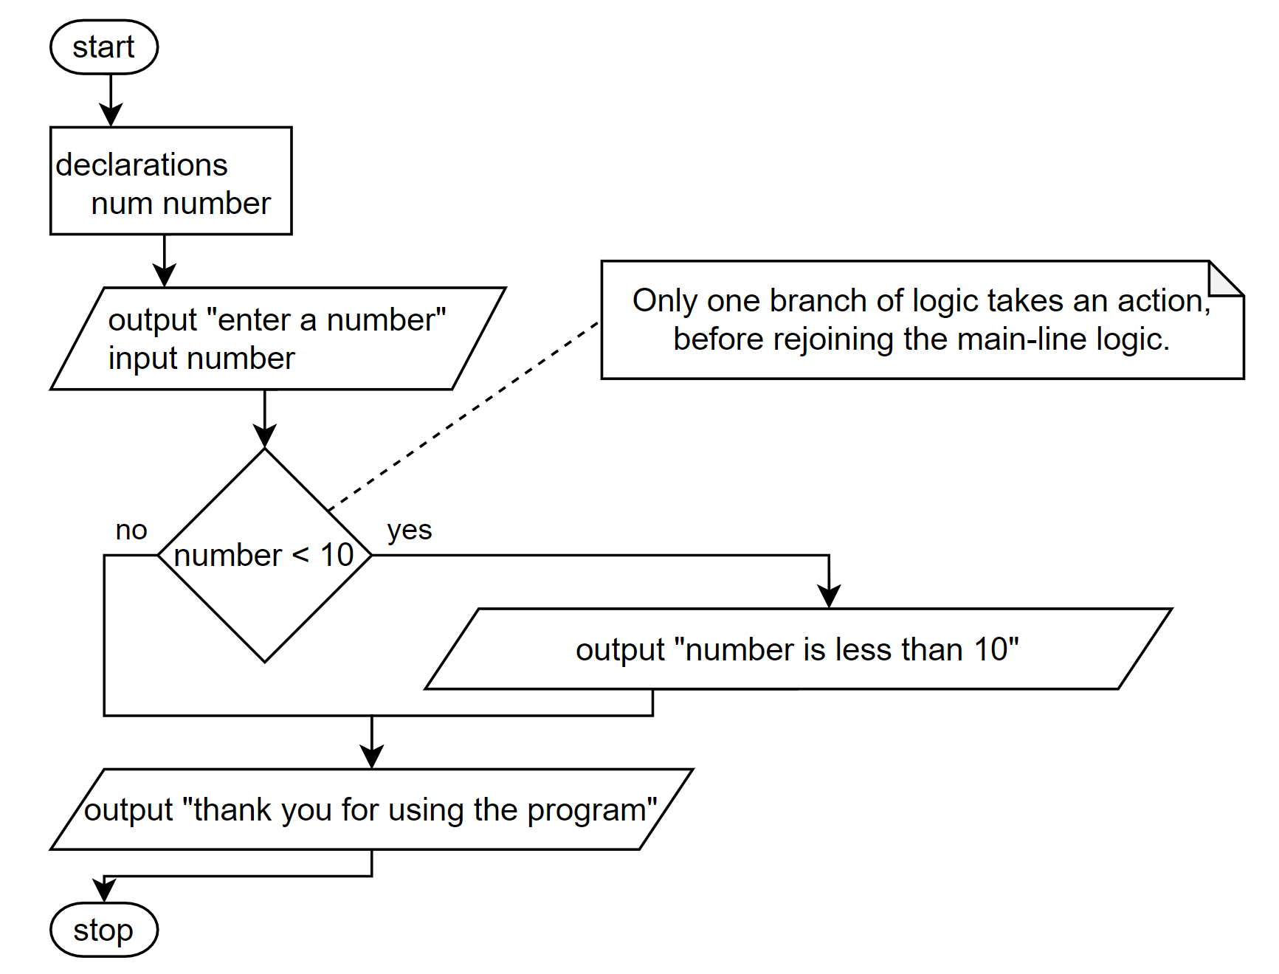
Single-alternative selection structure [1]
A simple program can obtain a user input numeric value and determine if it is less than 10 providing output if this is true.
start
declarations
num number
output "enter a number"
input number
if number < 10 then
output "number is less than 10"
endif
output "thank you for using the program"
stop

Slide 6
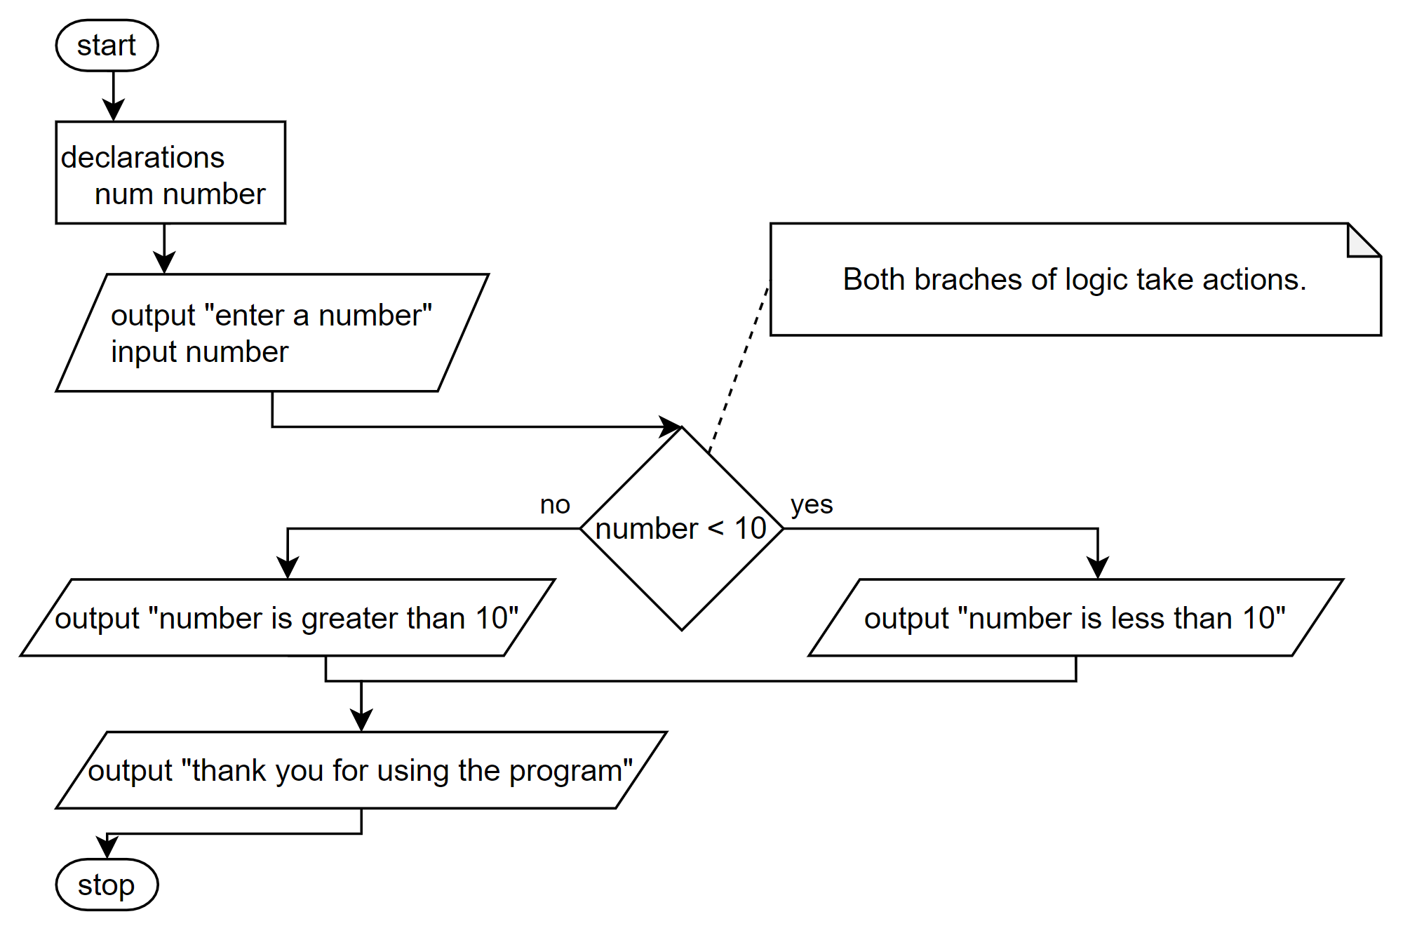
Dual-alternative selection structure [1]
Determine if it is less than 10 or greater than 10:
start
declarations
num number
output "enter a number"
input number
if number < 10 then
output "number is less than 10"
else
output "number is greater than 10"
endif
output "thank you for using the program"
stop

Slide 7
What about 10?
If you missed it, a value that is exactly 10 will be reported by the program as greater than 10. The program only checks for less than 10, otherwise it will report greater than 10, it does not address if the value is exactly 10.
Either need to ask the client the program is for, if 10 needs to be in the lower-range, or upper-range i.e. use <= or <
or, if the value 10 needs special treatment we may need to nest one if structure within the other
indentation is used to help visualize the structures.

Slide 8
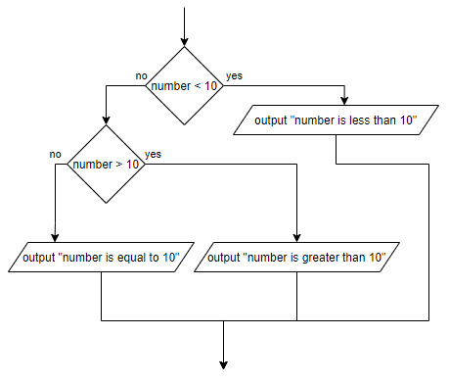
Nested Selection Structure (less, greater, equal 10)
start
declarations
num number
output "please enter a number"
input number
if number < 10 then
output "number is less than 10"
else
if number > 10 then
output "number is greater than 10"
else
output "number is equal to 10“
endif
endif
output "thank you for using the program"
stop

Slide 9
Nested Selection Structure Alternative Solutions
Alternative solutions are possible.
Test your learning:
Can you re-write the decision structure above to start with checking if the number equals 10 as well as draw a flowchart?
Can you re-write the decision structure to start with checking if the number is greater than 10 as well as draw a flowchart?
For this trivial example, there will not be (m)any changes to the structure itself, however there are cases where carefully choosing the order of the logic impacts the number of decisions needed to solve the problem.

Slide 10
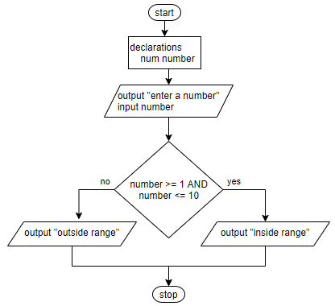
Using AND and OR
By using the AND, and OR operators we can make more complicated decisions.
E.g. is a number is within a range of values, or outside a range of values. E.g. AND
start
declarations
num number
output "please enter a number"
input number
if number >= 1 AND number <= 10 then
output "inside range
else
output "outside range"
endif
stop

Slide 11
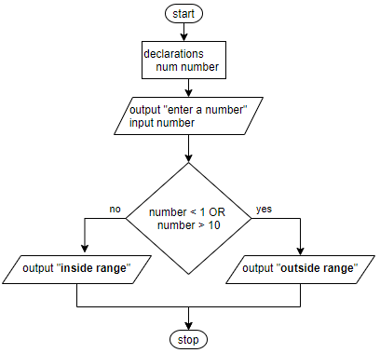
Using AND and OR
By using the AND, and OR operators we can make more complicated decisions.
E.g. is a number is within a range of values, or outside a range of values. E.g. OR
start
declarations
num number
output "please enter a number"
input number
if number < 1 OR number > 10 then
output "outside range"
else
output "inside range"
endif
stop

Slide 12
Testing Boundary Cases
Programmers cannot test all possible values that could go into a program.
Instead, we focus on boundary cases, also called border cases.
For a program that verifies that a number is between 1 to 10 this is a sample test plan.
External Input (user) | Expected Output | Actual Output | Description
0 | Outside range | Outside range | Matches expectations. Number below lower range
1 | Inside range | Inside range | Matches expectations. Number is valid equal to lower range.
5 | Inside range | Inside range | Matches expectations. Number is valid
10 | Inside range | Inside range | Matches expectations. Number is valid equal to upper range.
11 | Outside range | Outside range | Matches expectations. Number above upper range.

Slide 13
Using AND and OR together
When using AND & OR together in expressions remember order-of-operations
For a movie theater, if the customer is younger than 12 or older than 65, and the movie is rated G a discount is applied to the ticket sale ([1] pp 161)
if age <= 12 OR age >= 65 AND rating = “G” then
output “Discount applies”
endif
The Bug?: Anyone 12 and under will get a discount, true OR false is true.
To fix use ( and )
if (age <= 12 OR age >= 65) AND rating = “G” then
output “Discount applies”
endif

Slide 14
NOT operator (negative logic)
The NOT operator can be used to flip logic which can simplify a selection structure.
There are times where you need to take no action if a condition is true, but take action when it is false. For example this program needs to provide a warning if a value is not equal to 42, but it looks strange without NOT:
if number = 42 then
else
output "not 42"
endif
No instructions here, looks awkward
Compare (NOT)
if NOT (number = 42) then
output “not 42"
endif
Compare (Not-equals, <>)
if number <> 42 then
output "not 42"
endif
Compare (OR)
if number < 42 OR
number > 42 then
output "not 42"
endif

Slide 15
Nested logic for ranges of values
Where an if-statement is evaluated top-down sequentially, and only one branch of logic per if-else is processed, you do not need to check each range of values.
Assume that there are letter grades with ranges at a school:
Percent Grade Letter Grade Numeric Grade
80 – 100 A 4.0
70 – 79 B 3.0
60 – 69 C 2.0
50 – 59 D 1.0
0 – 49 F 0.0
To determine a student grade based on an entered integer number that falls between a range we could use a sequence of statements with AND logic, but should we or can things be simpler (see next slides)

Slide 16
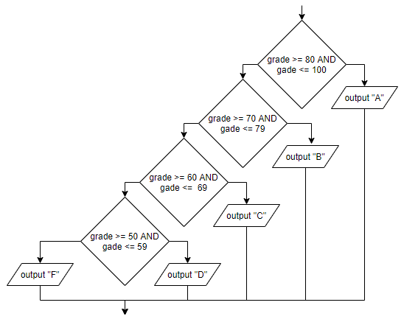
Nested logic for ranges of values (AND not needed)
if grade >= 80 AND grade <= 100 then
output "A"
else
if grade >= 70 AND grade <= 79 then
output "B"
else
if grade >= 60 AND grade <= 69 then
output "C"
else
if grade >= 50 AND grade <= 59 then
ouput "D"
else
output "F"
endif
endif
endif
endif
There is a problem: someone with a score more than 100 would get F.

Slide 17
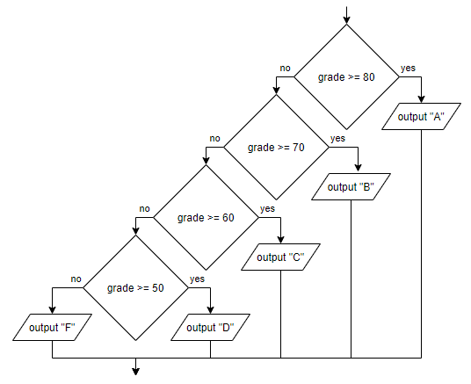
Nested logic for ranges of values (simplified)
if grade >= 80 then
output "A"
else
if grade >= 70 then
output "B"
else
if grade >= 60 then
output "C"
else
if grade >= 50 then
ouput "D"
else
output "F"
endif
endif
endif
endif
If already know a value is not >= 80, no need to check again, just ask is it >= 70 and so on

Slide 18
Selection Structure: Case
The case Structure (known as switch in Java)
This is a specialized selection structure that matches a value against single values.
Note: If a decision needs to be made based on a value exactly matching a set of values this is a good choice of decision structure
However, if you need to make decisions based on ranges of values, the nested if-else is much better.
Similar to else, you can provide a default branch of logic.

Slide 19
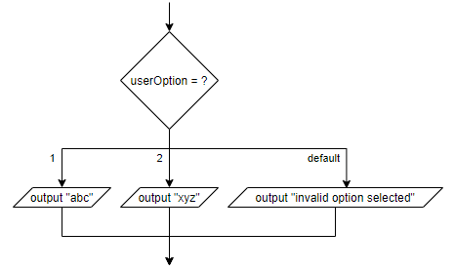
Selection Structure: Case
Here is a simple example where a user enters one of two options in operating a program, based on numeric integer input.
start
declaration
num userOption
output "Please enter 1 or 2 for option"
input userOption
case userOption
1:
output "abc"
2:
output "xyz"
default:
output "invalid option selected"
endcase
stop
Typically Magic Numbers, like 1 and 2 above, are replaced with constants e.g. OPTION_ABC, OPTION_XYZ

Slide 20
Conclusion
In this lesson we reviewed:
Structured Programming Overview
Selection Structure, also called Decision Structure
Single-alternative selection structure
Dual-alternative selection structure
Nested Selection Structure
Using AND and OR
Testing Boundary Cases
Using AND and OR together
NOT operator (negative logic)
Nested logic for ranges of values
Selection Structure: Case

Slide 21
References
[1] Joyce Farrell. 2018. Programming Logic & Design Comprehensive. 9th Ed. Cengage Learning. Chapter 4 pp. 124 to 167
[2] Cay Horstmann. 2019. Big Java Early Objects. 7th Ed. Wiley. Chapter 5 pp. 131 to 170

